Slide 1
Introduction to FEWD and the role of HTML/CSS/JS
Session 1 (slot 1)

Slide 2
Objectives
What is Front-End Web Development?
Describe the evolution of Dynamic Websites
Describe the role of HTML/CSS/JS
HTML Examples

Slide 3

What is Front-End Web Development?
FEWD is the development of those elements of a website that user sees and interactions with directly (Wikipedia)
ex: If a website were a car , FEWD would be………..?

Slide 4
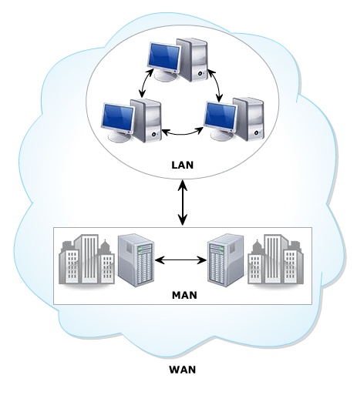
Evolution of web
The growth of computing expanded in multiple.
Organizations connect together to share data.
This makes the beginning of computer networks.

Slide 5
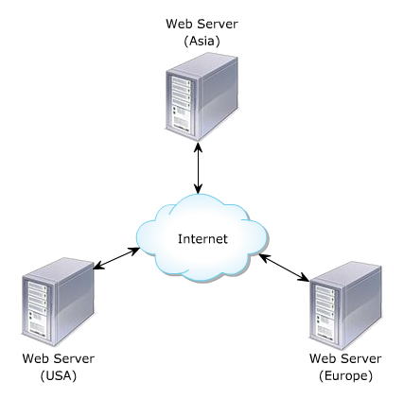
Web and Internet
WANs raised a strong need about global data sharing
This resulted referred as WWW.
Internet is known as the largest WAN.

Slide 6
Web can be classified
Web 1.0.
Web 2.0.
Semantic Web.

Slide 7
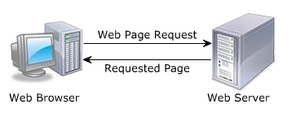
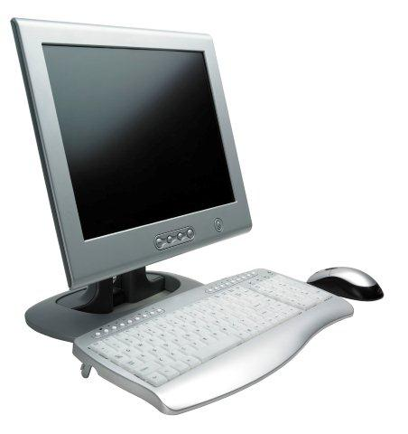
Web 1.0
To be Known as traditional web.
Authors write/publish content on the web.
The published content has read-only format.
Posing the problem of User interactivity.
read
Internet
write
Web Author
Web Reader

Slide 8
Web 2.0
Web 2.0 also called as the read-write web.
But the communication problem was fixed.
Readers can interact the authors by providing comments, blogs, queries, rating and so on.

Slide 9
Web 2.0
It’s great platform for the readers to share their viewpoints with the authors.
The Web space is limited in web 1.0 and 2.0.
read/write
Internet
read/write
Web Author
Web Reader

Slide 10
Semantic web
Concept to be expected as the future of web.
It is the read-write-request web.
The user can send the request for Web space.
Web
read/write/request
read/write/request
Semantic
Web space
Semantic
Web space
Web Author
Web Reader

Slide 11
Static web pages
Static web pages have a limitations.
Difficult to maintain.
Updated manually.
Inconsistency.
Don’t allow any user interaction.

Slide 12
Dynamic web pages
Allows customizing the content and its appearance in the browser.
Generates content “on-demand”.
Accepts the user inputs through web browser.
Several technologies evolved to make web sites more flexible and dynamic.
Variety device such as PDAs, Cell phones, and so on is used XHTML Documents

Slide 13
The role of HTML/CSS/JS
W3C is an organization that maintains the standards of technologies used to develop web pages and web sites.
HTML is a Hypertext Markup Language
HTML allows the web designers to create various web sites.
CSS (Cascading Style Sheets) is created to separate the structure and presentation of an HTML.

Slide 14
The role of HTML/CSS/JS
JavaScript is the programming language of HTML and the Web.
Programming makes computers do what you want them to do.
JavaScript is easy to learn.

Slide 15
A small HTML example:
<!DOCTYPE html> <html> <head> <title>Page Title</title> </head> <body> <h1>My First Heading</h1> <p>My first paragraph.</p> </body> </html>
Try it Yourself

Slide 16
Dynamic web sites
<!DOCTYPE HTML PUBLIC "-//W3C//DTD XHTML 1.1//EN" "http://www.w3.org/TR/xhtml11/DTD/xhtml11.dtd">
<HTML xmlns="http://www.w3.org/1999/xhtml">
<HEAD>
<TITLE>Introduction to XHTML</TITLE>
</HEAD>
<BODY>
This is an XHTML page.
</BODY>
</HTML>

Slide 17
Summary
Web 1.0 is a Read-or-Write web that does not allow interaction.
Web 2.0 is a Read-Write Web that allows the readers to provide blogs, comments…
A XHTML is a HTML document that uses Grammatical structure of XML.
Ever XHTML document must have the DOCTYPE declaration at the top.

